Slide 1

Water potability Prediction
MEMBERS:
MUHAMMED ADILSHA TP
SAKSHI SHAILESH PISAL
VISHAL KAKASAHIB DUKARE
RITESH SUNIL DHARMEKAMBELE
NEHA BHAGWAT BIDWE
RAHUL KAILAS GILORKAR
MENTOR:
RITESH
07/06/2022
To be filled by Project group

Slide 2
Business Problem:
In here my project water potability aim about about the water is drinkable or not and in this there are several factors that effect to the water. ph value is one of the main factor that effect on water. and that kind several factors that are effecting to the water so here my main problem that I need to know my prediction is more accurate to that when I insert value into model I need to get correct output. So I need to make sure that my model will be good .and in this project I got many null so I need to handle my data carefully.
Objective:
The objective of the analysis is to predict an item when sold, what is the probability that customer would file fraudulent / Genuine warranty and to understand important factors associated with them
The main objective of the problem is by through our input our model need to identify weather the water is potable or not.
The dataset is having incidents raised by customers.Which contains an event log of an incident management process extracted from a service desk platform of an IT company

Slide 3
Project Architecture / Project Flow
Water potability is a supervised classification project that predict the water is potable or not.
Components
1.Problem
This is the top, fundamental component. I have listed many problems in my work. It can be
Anything from building a market segmentation, building the model that give water is drinkable or not. And in this only have low data so it will effect on accuracy of data, and it will effect for the prediction. And they give several component that effect to water drinkable or not . And here we need to train data on that basis so it will more challenging.
2.Data
It comes in many shapes like unstructured data, real time and so on . Typically
Raw data needs to be identified and event building and store the data then clean the data and aggregate using EDA . The process can be include selecting and defining metrics.
3.Algorithms
Also called techniques . Example include Decision tree , indexation algorithm , light gradient boosting ,support vector machines and go on. And it done in a specific manner.
4.Models
By models, I mean testing algorithms, selecting, fine-tuning, and combining the best -

Slide 4
Algorithm using techniques such as model fitting, model blending, data reduction, feature selection, and assessing the yield of each model, over the baseline. It also includes calibrating or normalizing data, imputation techniques formissing data ,outlier detection, cross-validation, over-fitting avoidance, robustness testing and boosting, and maintenance. Criteria that make a model desirable include robustness and stability, scalability, simplicity, speed, portability, adaptability , and accuracy.
5.Programming
There is almost always some code involved, even if you use any kind of solution. Typically, data scientists use python, R, or java, html, CSS, SQL etc.. I completed my project using python code for model and also in deployment level.
6.Enivironments
Some call it packages. It can be anything such as a bare unix box accessed remotely combined with scripting languages and data science libraries such as pandas (python), or anything.
7.Presentation
By presentation , I mean presenting the results. Not all data science projects run continuously in the background , for instance to automatically buy stocks or predict the weather. Some are just ad-hoc analyses that need to be presented to decision makers,
Using some tools like excel, tablue, power bi etc.. In some kind other cases also data scientist business analysts to create dashboards, or to design alarm system, with result from some field.

Slide 5
Exploratory Data Analysis (EDA) and
Feature Engineering

Slide 6
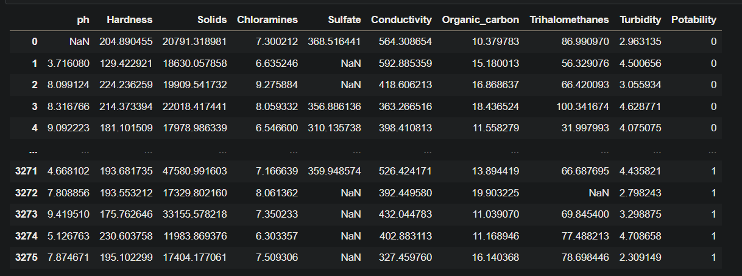
Data set details
Example
3276 rows and 10 columns .
Range Index: 3276 entries, 0 to 3275
Missing Value: Ph value =491,sulfate=781,Trihalomethanes=162

Slide 7
Exploratory Data Analysis (EDA)
60.98% of my data says the water is not potable
Other data says that the water is drinkable
In hist PH values more values lies under in 6 to 8. And I hardness the values is lies between 150 to 250. And in the case of solid the more is in between of 15000 to 30000 and in this data is little right skewed . And in the case of chloramines the more values is in between 6 to 9 and it little bit symmetric. Then the other one is sulfate data mainly lies on 300 to 350 and the graph shown like leptokurtic. And in the case of conductivity , trihalomethane and turbity all data shows a good normal graph.
The imbalance graph shows that the graph shows 0 ‘zeros’ is almost double of 1 ‘ones’ .
And for knowing outlier detection we plot some graphs like distplot and boxplot and by using this we can understand that some data are outliers

Slide 8
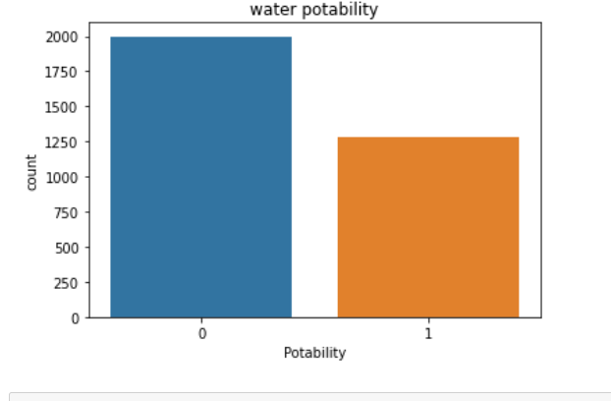
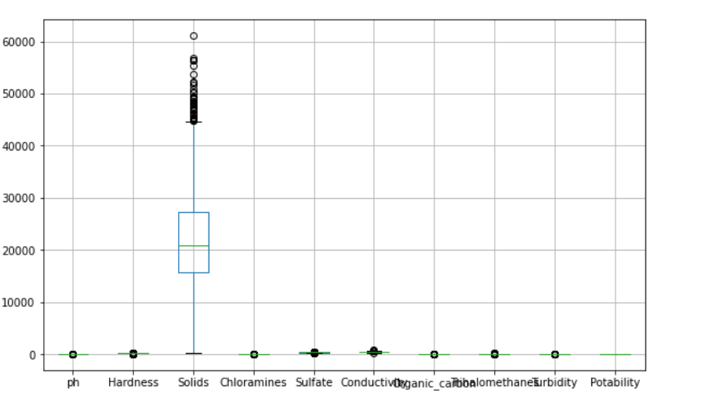
EDA
Look for problems in the data such as class imbalance dataset
2.Looking outliers in the data

Slide 9
Feature Engineering
The feature engineering help to prepare the proper input dataset, compatible with the machine learning algorithm requirments.
And also help to improve the performance of machine learning models.
In the case of our input datasets, here we have columns like ph , hardness , solids etc .. All this kind of columns are very important for our data model for the prediction of water is potable or not.
So here feature engineering, we don’t remove any columns.

Slide 10
Model Building

Slide 11
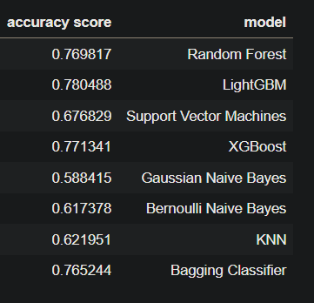
Template for Model results presentation

Slide 12
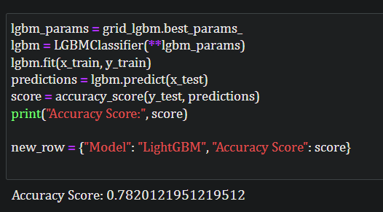
Model Predictions
Here I use light GBM as model for my project and I got 78.2% of accuracy for my dataset.
And we also use hyper tuning to my data for increase my accuracy.

Slide 13
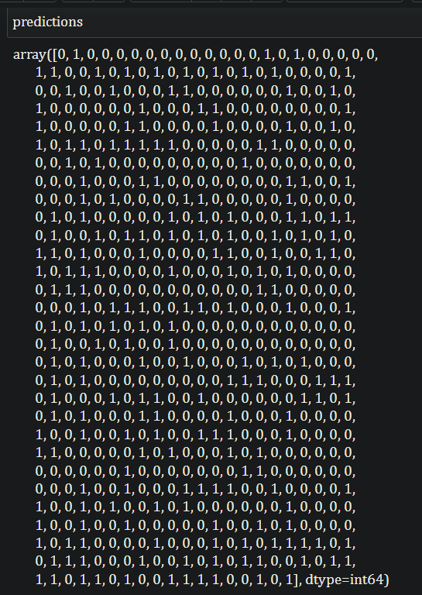
Model Results
Here in my model prediction most got output is zero’s compare to one’s

Slide 14
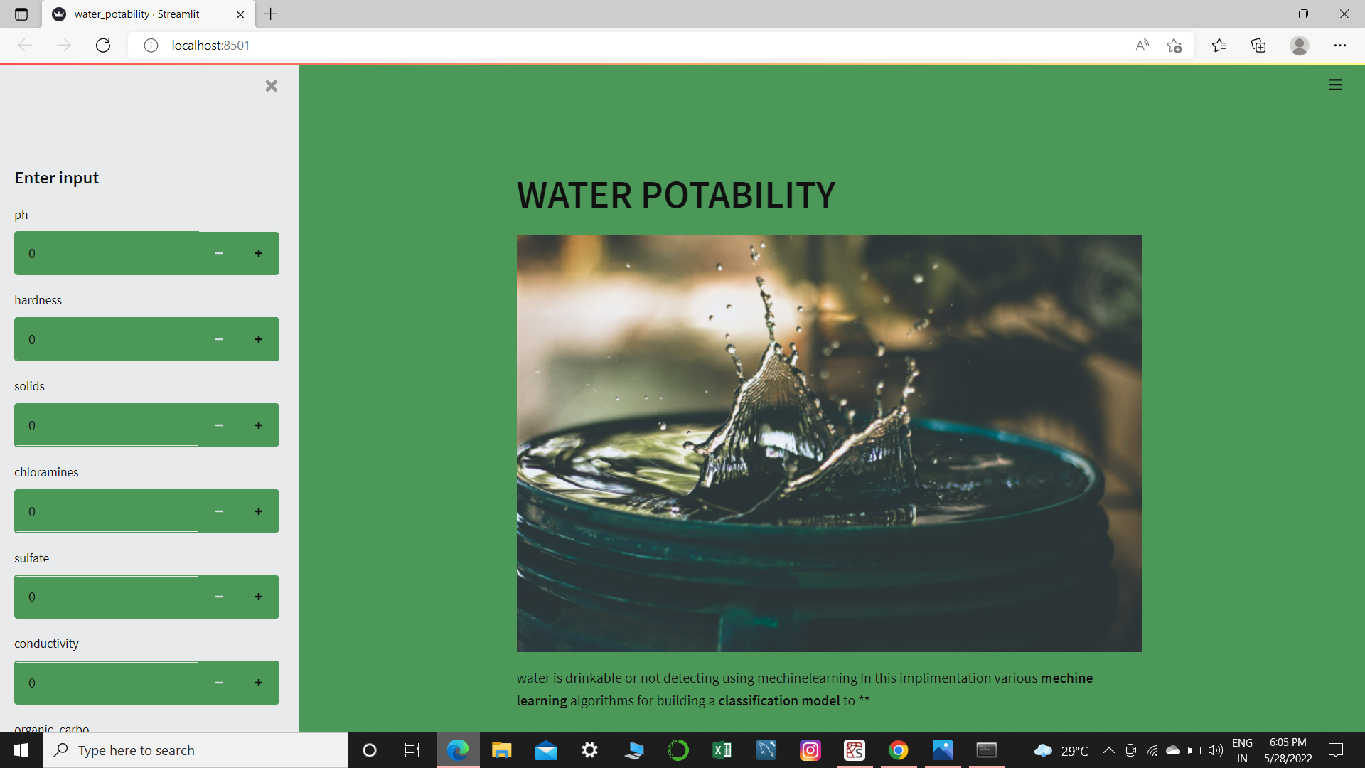
Model Deployment
We use Stream lit for deployment in this project. By using streamlit we can easily deploy over project.

Slide 15
Challenges faced?
.
The major challenge I face in this project is null values and data imbalance. In the case of null value my total data is 3276 and I got around 1400 null values and that will massively effect my data accuracy. And in the case target I got zero’s around double of one’s, that also effect my model prediction
How did you overcome?
We overcome the challenges by filling the null values and put data into balance. In the case of null values we over come by filling null values with mean by using group by function. And in the case of imbalance data we use class weight function to balance the dataset.

Slide 16
Thank you

